Slide 1


PRESENTATION : PHASE 2 – FINAL REVIEW
BATCH No.:
K - 6
DOMAIN:
Deep Learning and Image Processing
PROJECT TITLE :
Object Tracking From video input using Deep Learning
TYPE AND RELEVANCE OF PROJECT:
S. No. | Register number | Name of the Student
1 | Kolluri Anudeep | U18CN307
2 | Settyboyana Siva | U18CN266
3 | Talari Siva Koteswara Rao | U18CN268
4 | Kotha Sai Gopal | U18CN278
GUIDED BY:
Dr. B. Persis Urbana Ivy

Slide 2
PRESENTATION : PHASE 2 – FINAL REVIEW
AGENDA :
Objective
Applications
Literature Survey
Base paper
Existing system
Proposed system – Block Diagram
Hardware and Software Requirements
Implementation
Results and Discussion
Conclusion and Future scope
References

Slide 3
PRESENTATION : PHASE 2 – FINAL REVIEW
Objective
To detect and extract features from downloaded videos frame by frame and track the objects
Detection of objects from live video using webcam as input using python and openCV
3

Slide 4
PRESENTATION : PHASE 2 – FINAL REVIEW
Applications
Many problems in computer vision were saturating on their accuracy before a decade.
However, with the rise of deep learning techniques, the accuracy of these problems drastically improved.
One of the major problem was that of image classification, which is defined as predicting the class of the image.
There is no object detection in existing system by using Opencv
4

Slide 5
PRESENTATION : PHASE 2 – FINAL REVIEW
Literature Survey
S. No | Title | Author | Features
1 | SSD: Single Shot MultiBox Detector | Wei Liu and Alexander C. Berg | This method discretizes the output space of bounding boxes into a set of default boxes over different aspect ratios and scales per feature map location the network generates scores for the presence of each object category in each default box and produces adjustments to the box to better match the object shape
2 | Convolutional Neural Networks for Mobile Vision Applications | Andrew G. Howard, and Hartwig Adam | based on a streamlined architecture that uses depth-wise separable convolutions to build light weight deep neural networks effectiveness of MobileNets across a wide range of applications and use cases including object detection, finegrain classification, face attributes and large scale geo-localization.
5

Slide 6
PRESENTATION : PHASE 2 – FINAL REVIEW
Literature Survey
S. No | Title | Author | Features
3 | Ammunition Detection: Developing a Real-Time Gun Detection Classifier | Justin Lai, Sydney Maples | used a Tensorflow-based implementation of the Overfeat network as an integrated network for detecting and classifying weapons in images best performance was achieved on Overfeat-3 with 93% training accuracy and 89% test accuracy with adjusted hyperparameters
4 | UAV: Application of Object Detection and Tracking Techniques for Unmanned Aerial Vehicles | Shreyamsh Kamate | detecting and tracking moving objects which pose a primary security threat against the United States southern border assist the human operators, by implementing intelligent visual surveillance systems which help in detecting and tracking suspicious or unusual events in the video sequence
6

Slide 7
PRESENTATION : PHASE 2 – FINAL REVIEW
Literature Survey
S. No | Title | Author | Features
5 | Object detection with deep learning and OpenCV | Adrian Rosebrock | capturing a video from camera, storing the information in a database, and then required contents were accessed manually from the database classified in to five predefined classes namely human beings, cars, motor bikes, busses and horses by the method of features extraction and Comparision
6 | Object Tracking Algorithms for video surveillance applications | Akshay Mangawati, Mohana, Mohammed Leesan, H. V. Ravish Aradhya | wide range of applications such as object detection, traffic control, human-computer interaction, gesture recognition, video surveillance objects are tracked based on colour, motion of single and multiple objects (vehicles) are detected and counted in multiple frames
7

Slide 8
PRESENTATION : PHASE 2 – FINAL REVIEW
Base paper
Our Base Paper is downloaded from Ieexplore.
Link to base Link to basepaper : https://ieeexplore.ieee.org/document/9674450
8

Slide 9
PRESENTATION : PHASE 2 – FINAL REVIEW
Existing System
In the existing system they used mat lab for image processing and object detection.
The mat lab image processing is very time taking process and accuracy is also very low.
The cost for project design also very high.
9

Slide 10
PRESENTATION : PHASE 2 – FINAL REVIEW
Proposed System
Deep learning has gained a tremendous influence on how the world is adapting to Artificial Intelligence since past few years. Some of the popular object detection algorithms are Region-based Convolutional Neural Networks (RCNN), Faster- RCNN, Single Shot Detector (SSD) and You Only Look Once (YOLO).
In our project we are using Mobile net SSD for lightweight and fast results.
10

Slide 11
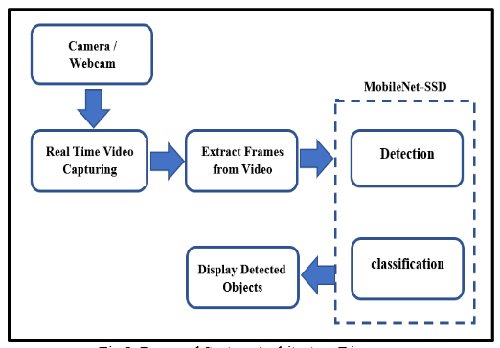
PRESENTATION : PHASE 2 – FINAL REVIEW
Proposed system architecture

Slide 12
PRESENTATION : PHASE 2 – FINAL REVIEW
System Requirements
HARDWARE REQUIREMENTS
Operating System : Windows, Linux
Processor : Minimum intel i3
Ram : minimum 4 gb
Hard disk : minimum 250 gb
SOFTWARE REQUIREMENTS
Python IDLE 3.7 version (or)
Anaconda 3.7 (or)
Jupyter Notebook (or)
Google Colab
12

Slide 13
PRESENTATION : PHASE 2 – FINAL REVIEW
Implementation
Modules
S.No | Module name
Module 1 | Browse System Videos
Module 2 | Webcam Video Tracking
13

Slide 14
PRESENTATION : PHASE 2 – FINAL REVIEW
Module 1
Browse System Videos: Using this module application allow user to upload any video from his system and application will connect to that video and start playing it, while playing if application detect any object then it will mark that object with bounding boxes, while playing video if user wants to stop tracking then he need to press ‘q’ key from keyboard to stop video playing.
14

Slide 15
PRESENTATION : PHASE 2 – FINAL REVIEW
Module 2
Start Webcam Video Tracking: Using this module application connect itself with inbuilt system webcam and start video streaming, while streaming if application detect any object then it will surround that object with bounding boxes, while playing press ‘q’ to stop web cam streaming.

Slide 16
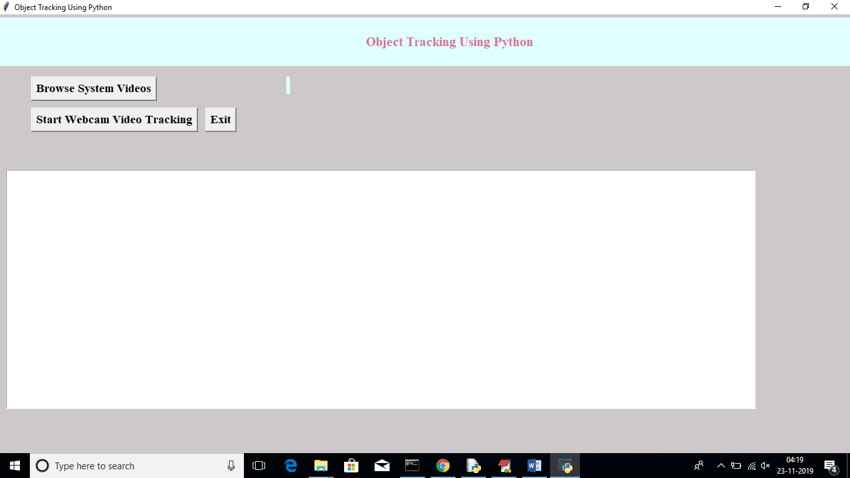
PRESENTATION : PHASE 2 – FINAL REVIEW
16

Slide 17
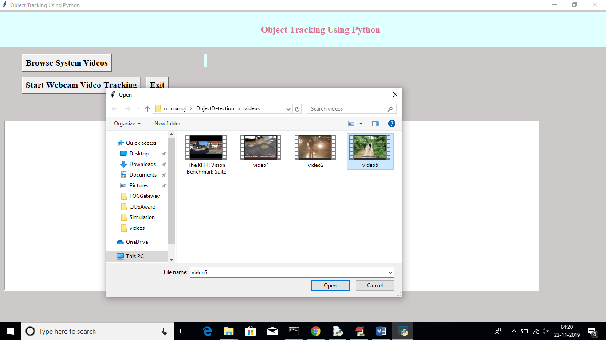
PRESENTATION : PHASE 2 – FINAL REVIEW

Slide 18
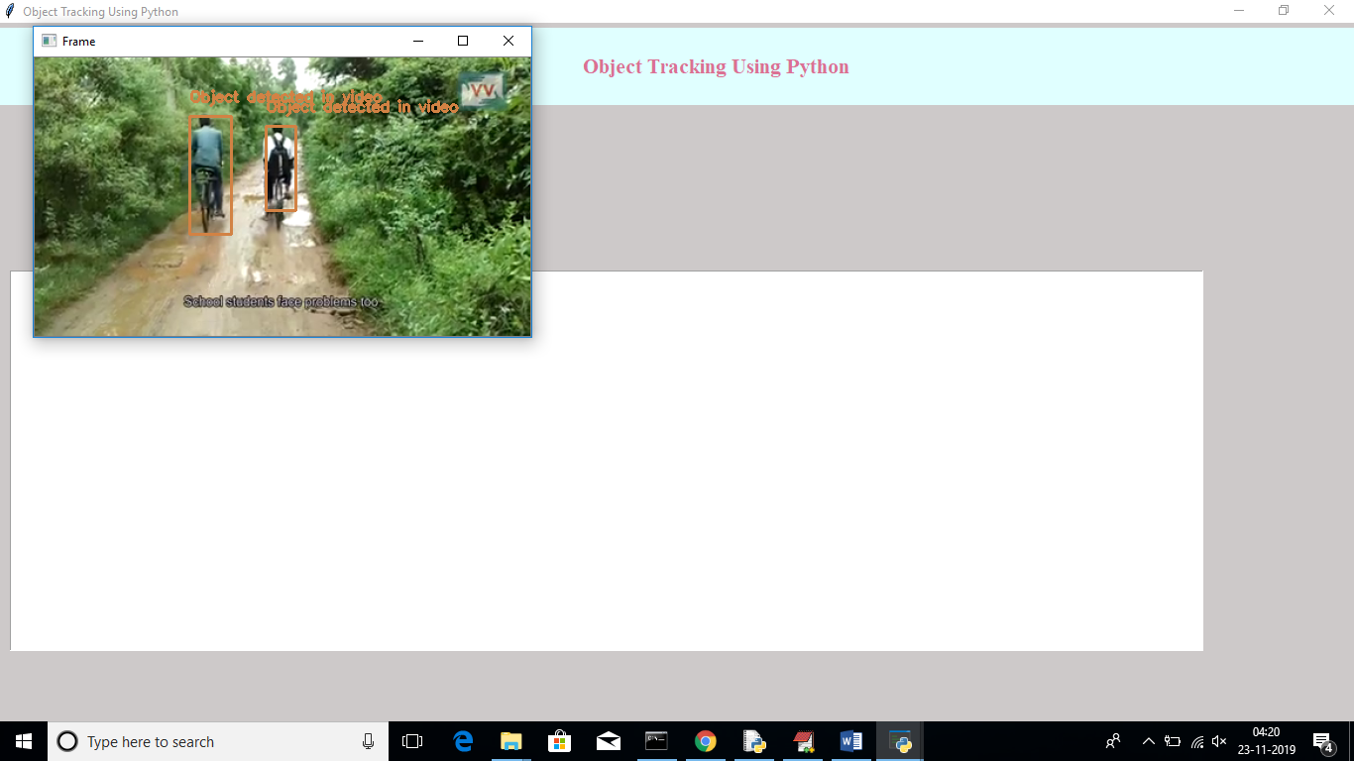
PRESENTATION : PHASE 2 – FINAL REVIEW

Slide 19
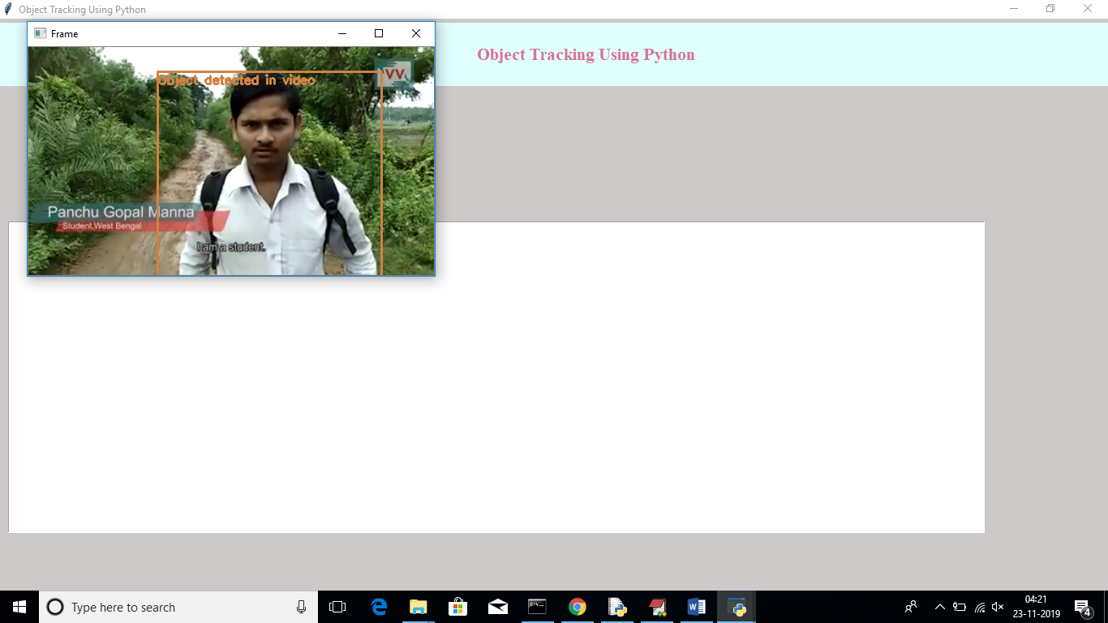
PRESENTATION : PHASE 2 – FINAL REVIEW

Slide 20
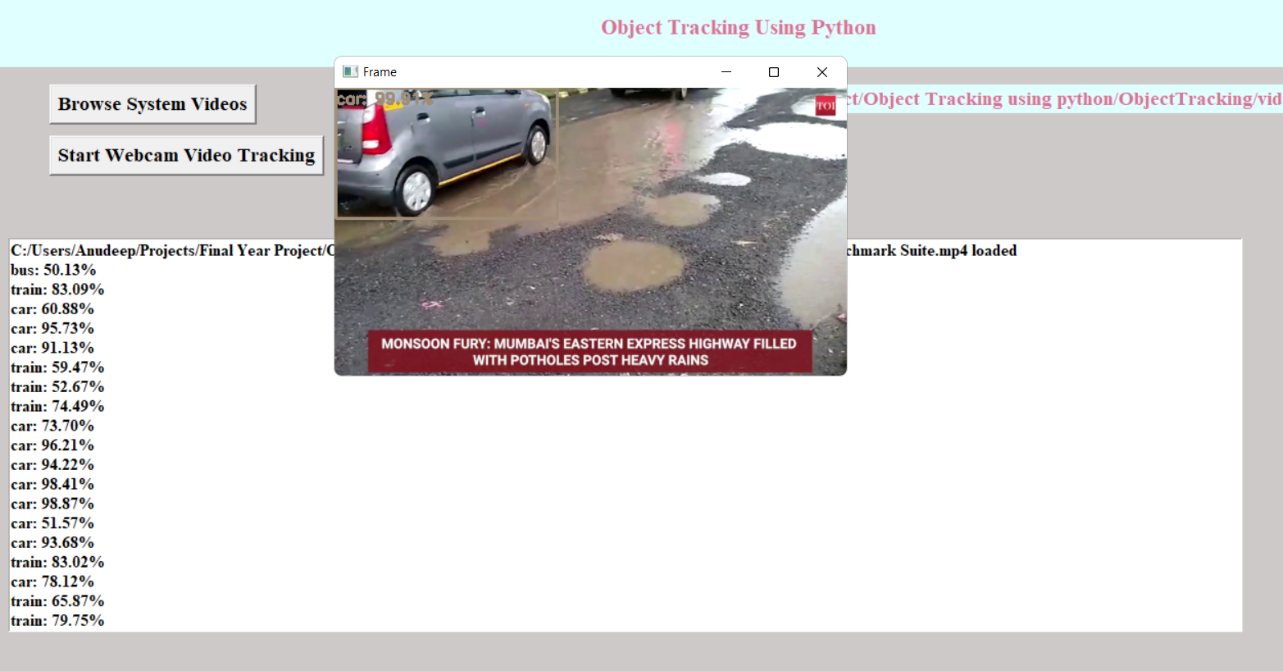
PRESENTATION : PHASE 2 – FINAL REVIEW

Slide 21
PRESENTATION : PHASE 2 – FINAL REVIEW
CONCLUSION
An accurate and efficient object detection system has been developed which achieves comparable metrics with the existing state-of-the-art system. This project uses recent techniques in the field of computer vision and deep learning.
21

Slide 22
PRESENTATION : PHASE 2 – FINAL REVIEW
References
[1] Wei Liu and Alexander C. Berg, “SSD: Single Shot MultiBox Detector”, Google Inc., Dec 2016.
[2] Andrew G. Howard, and Hartwig Adam, “MobileNets: Efficient Convolutional Neural Networks for Mobile Vision Applications”, Google Inc., 17 Apr 2017.
[3] Justin Lai, Sydney Maples, “Ammunition Detection: Developing a Real-Time Gun Detection Classifier”, Stanford University, Feb 2017
[4] Diederik Kingma and Jimmy Ba. Adam: A method for stochastic optimization. arXiv preprint
ArXiv:1412.6980, 2014.
[5] T. Tieleman and G. Hinton. Lecture 6.5-rmsprop: Divide the gradient by a running average
of its recent magnitude. COURSERA: Neural Networks for Machine Learning, 4(2),2012.
22

Slide 23
PRESENTATION : PHASE 2 – FINAL REVIEW
[6] Shreyamsh Kamate, “UAV: Application of Object Detection and Tracking Techniques for Unmanned Aerial Vehicles”, Texas A&M University, 2015.
[7] Adrian Rosebrock, “Object detection with deep learning and OpenCV”, pyimagesearch.
[8] Mohana and H. V. R. Aradhya, "Elegant and efficient algorithms for real time object detection, counting and classification for video surveillance applications from single fixed camera," 2016 International Conference
on Circuits, Controls, Communications and Computing (I4C), Bangalore, 2016, pp. 1-7.
[9] S. Ioffe and C. Szegedy. Batch normalization: Accelerating deep network training by reducing internal covariate shift. arXiv preprint arXiv:1502.03167, 2015.
[10] M. Abadi, A. Agarwal, P. Barham, E. Brevdo, Z. Chen, C. Citro, G. S.Corrado, A. Davis, J. Dean, M. Devin, et al. Tensorflow: Large scale machine learning on heterogeneous systems, 2015. Software available from tensorflow. org, 1, 2015.
[11] Timothy Dozat (2016). INCORPORATING NESTEROV MOMENTUM INTO ADAM. Workshop track - ICLR 2016.
https://openreview.net/pdf?id=OM0jvwB8jIp57ZJjtNEZ.

Slide 24
PRESENTATION : PHASE 2 – FINAL REVIEW
[12] M. Abadi, A. Agarwal, P. Barham, E. Brevdo, Z. Chen, C. Citro, G. S. Corrado, A. Davis, J. Dean, M. Devin, et al. Tensorflow: Large scale machine learning on heterogeneous systems, 2015. Software available from tensorflow. org, 1, 2015. [13] Timothy Dozat (2016). INCORPORATING NESTEROV MOMENTUM INTO ADAM. Workshop track - ICLR 2016. https://openreview.net/pdf?id=OM0jvwB8jIp57ZJjtNEZ. [14] Diederik Kingma and Jimmy Ba. Adam: A method for stochastic optimization. arXiv preprint arXiv:1412.6980, 2014. [15] T. Tieleman and G. Hinton. Lecture 6.5-rmsprop: Divide the gradient by a running average of its recent magnitude.
COURSERA: Neural Networks for Machine Learning, 4(2),2012.

Slide 25
PRESENTATION : PHASE 2 – FINAL REVIEW
Thank you

